Slide 1
SDR-Based Spectrum Sensing
Student’s Name:
Amitesh Singh(211010214)
Bhavesh Balendra(211010221)
Guided By : Dr. Shrivishal Tripathi
International Institute of Information Technology, Naya Raipur

Slide 2
Introduction
SDR-Based Spectrum Sensing refers to the process of detecting and characterizing signals in the electromagnetic spectrum using Software-Defined Radio (SDR) technology. SDR technology enables radio communication systems to be implemented in software, which makes it possible to reconfigure or reprogram the radio systems in real-time.
*
International Institute of Information Technology, Naya Raipur
‹#›

Slide 3
Aim
To detect used frequency in the spectrum band.

Slide 4
Proposed Solution
Discover used frequency band using RTL-SDR.
Then, use any unused frequency band using USRP Transmitter and generate signal .
Receive signal using RTL-SDR.

Slide 5
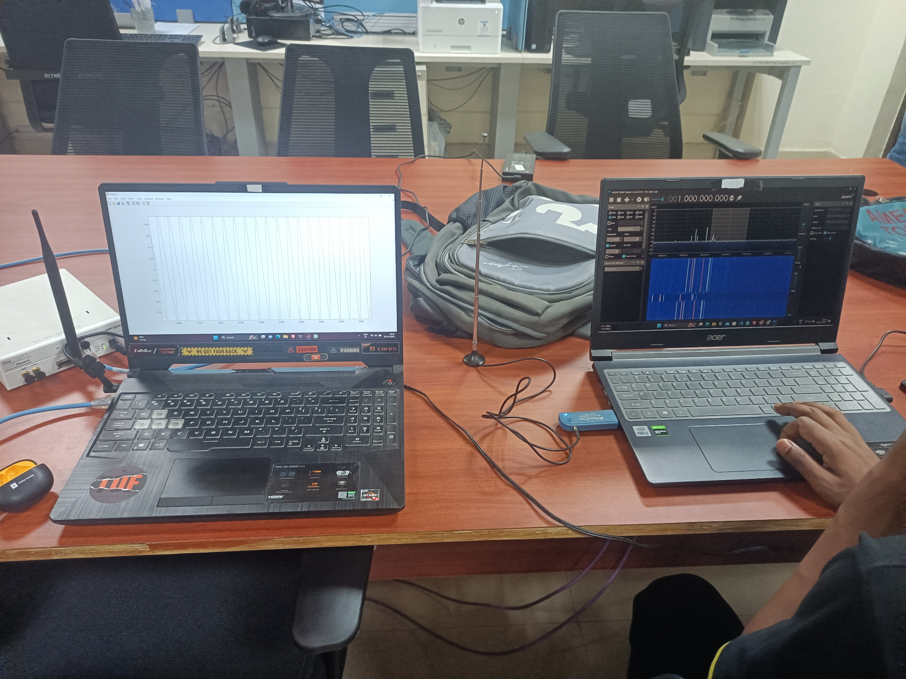

Slide 6
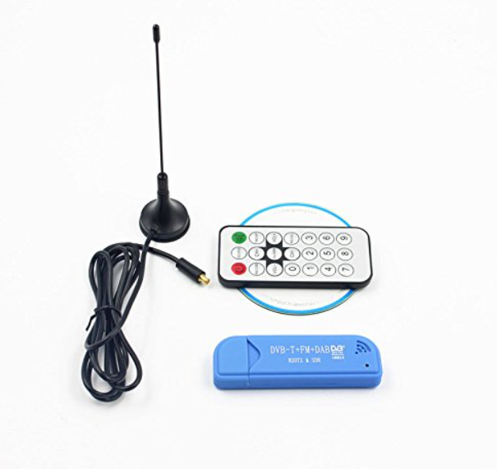
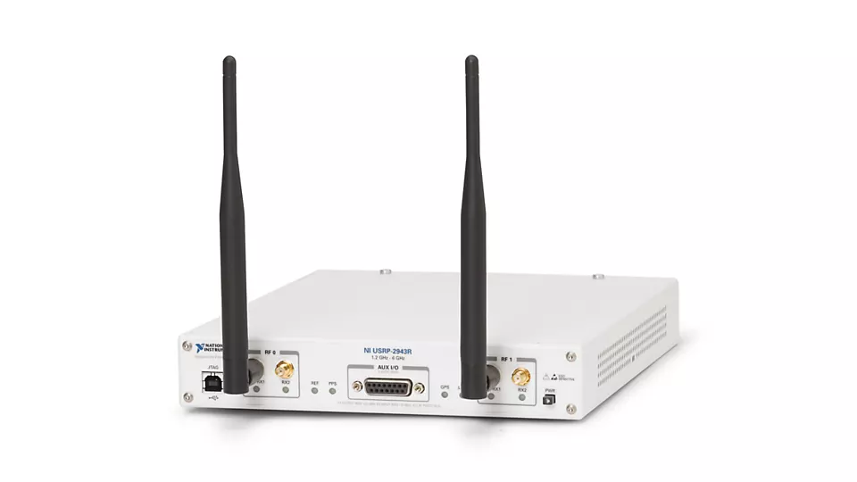
Hardware Used
RTL-SDR(RTL2832U R820T2)
Antenna
USRP Transmitter
*
International Institute of Information Technology, Naya Raipur
‹#›

Slide 7

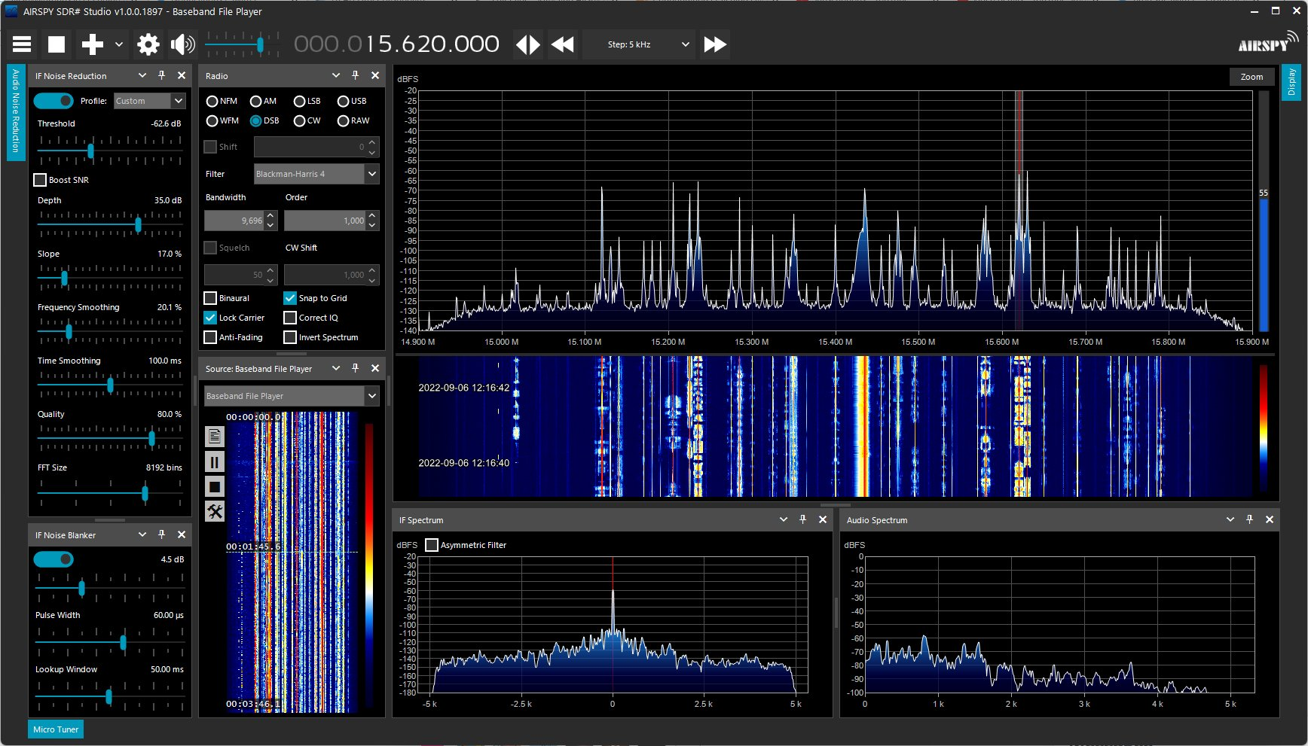
Software Used

Slide 8
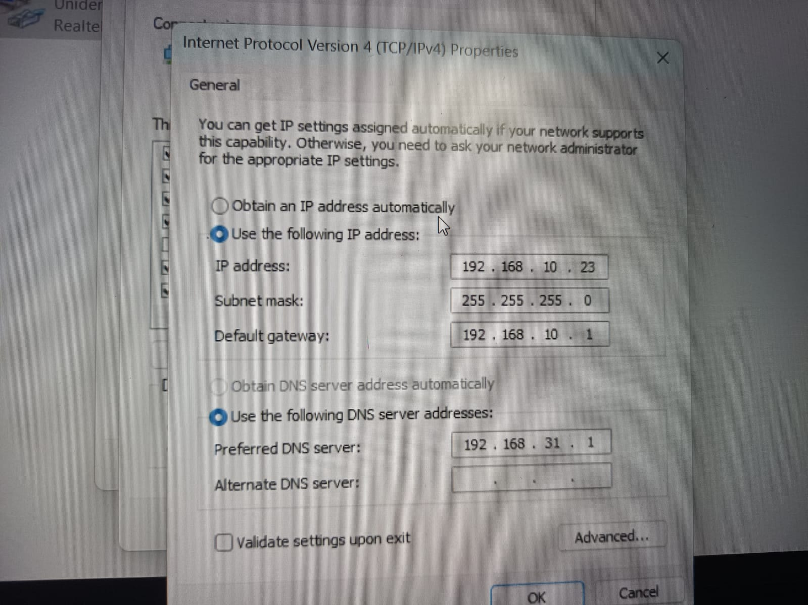
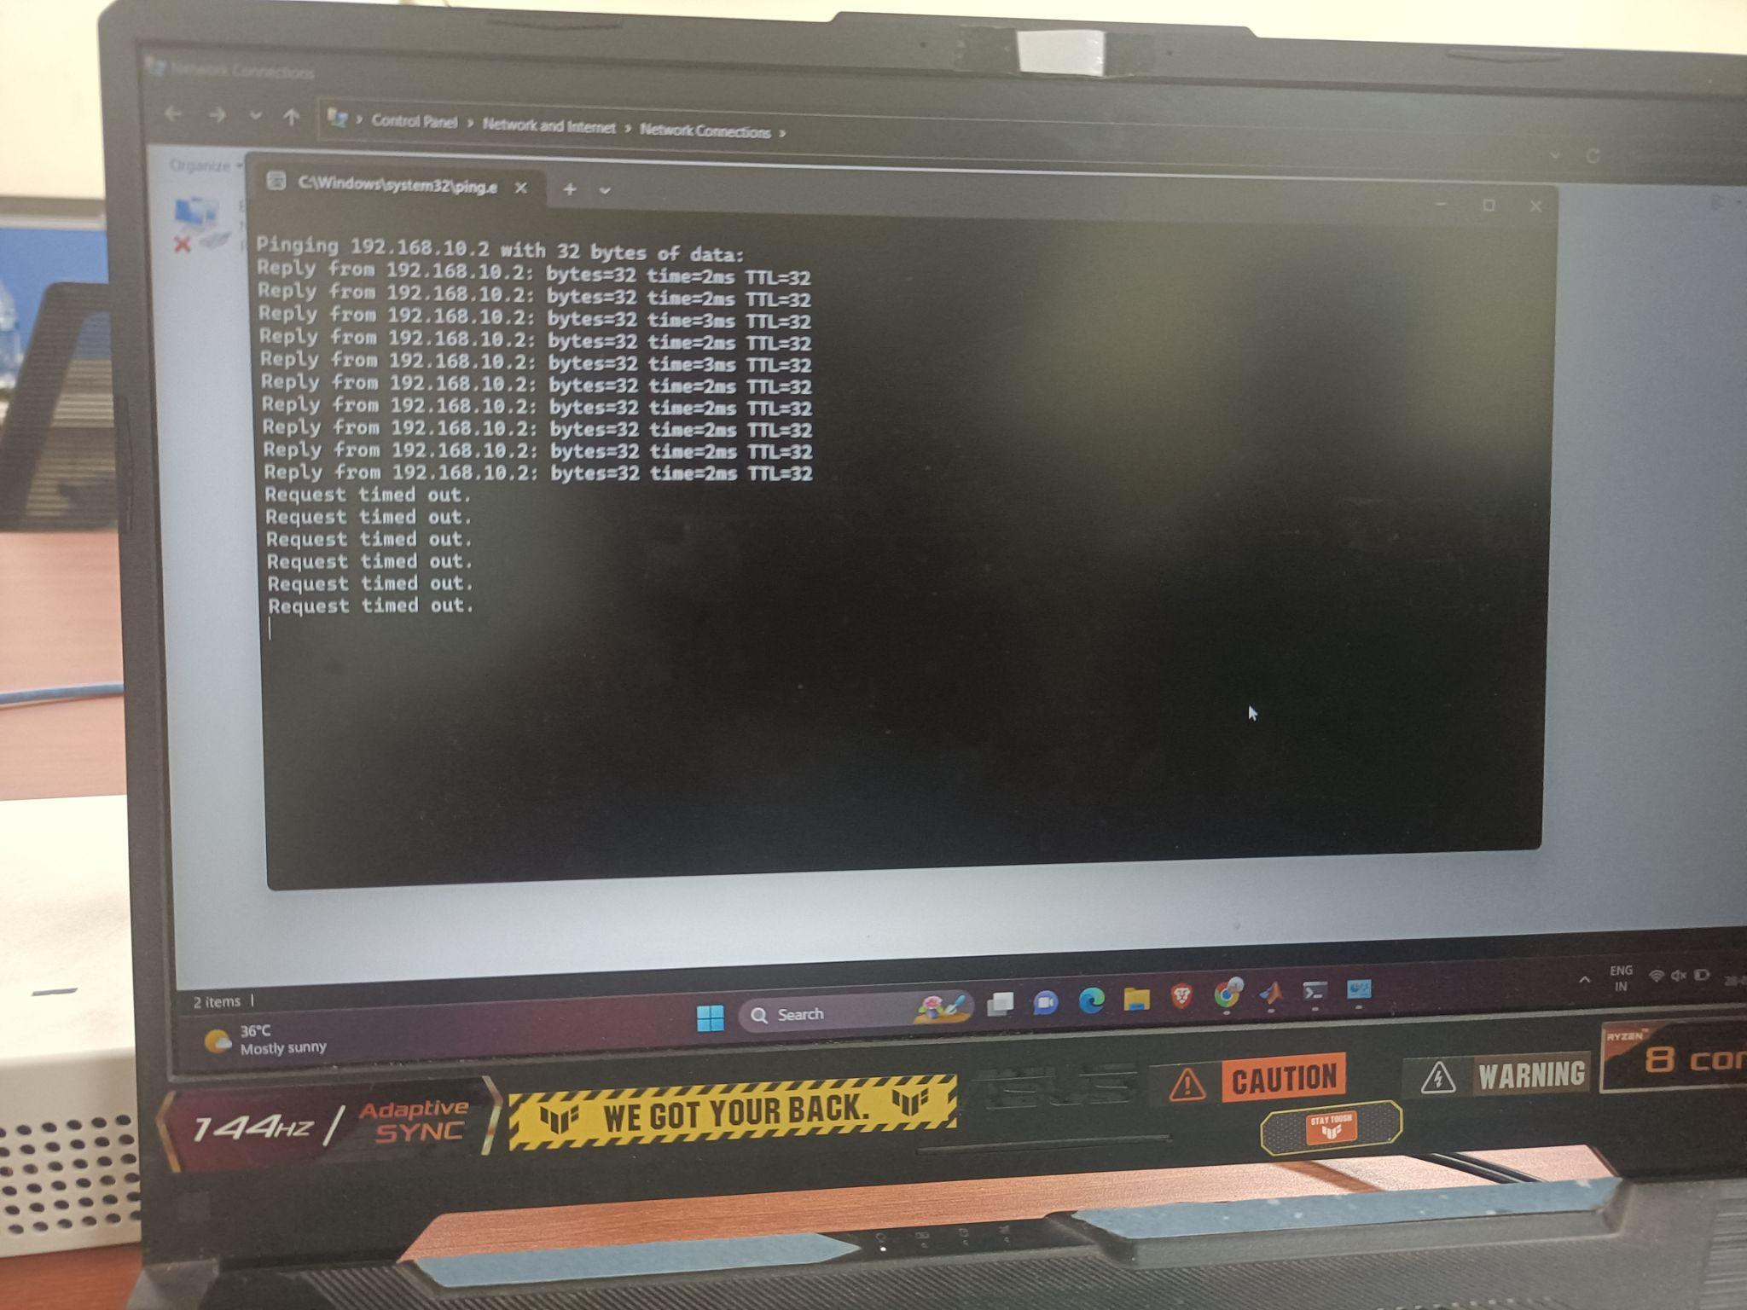
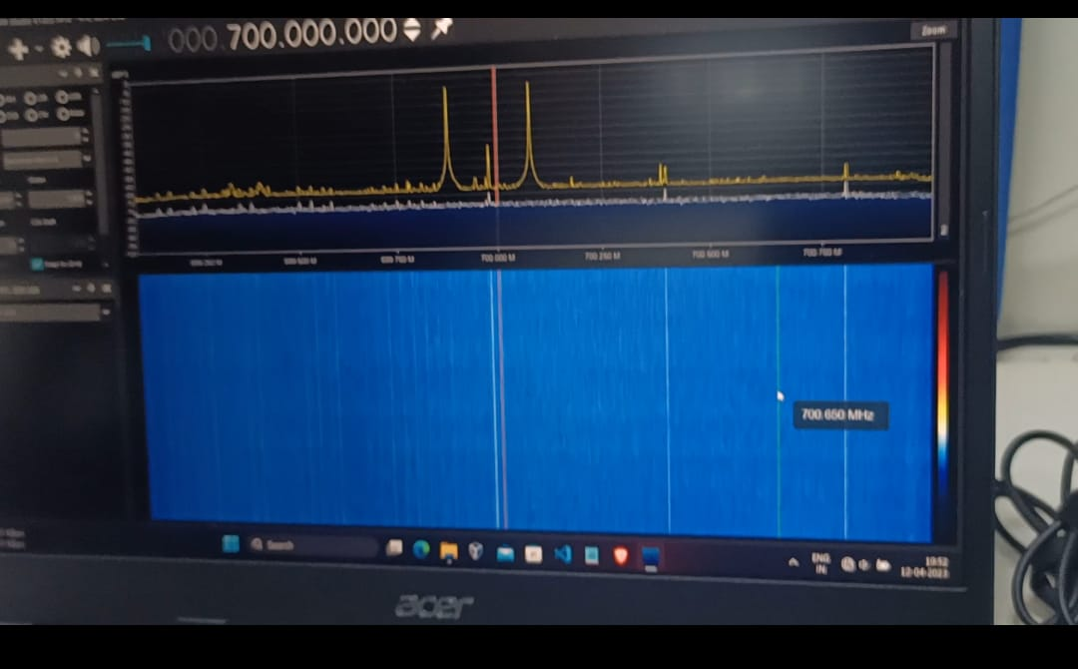
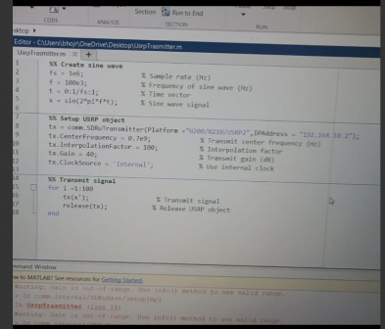

Slide 9
Output of SDR#

Slide 10
Result
Range of RTL-SDR is from 24 Mhz to 1.7Ghz
Audio is quite not audible.
*
International Institute of Information Technology, Naya Raipur
‹#›

Slide 11

Thank you
..
Dr. Shyama Prasad Mukherjee International Institute of Information Technology, Naya Raipur
*
International Institute of Information Technology, Naya Raipur
‹#›

